Slide 1
Matrix Multiplication In CUDA using shared memory

Slide 2
What is CUDA?
CUDA is a set of developing tools to create applications that will perform execution on GPU (Graphics Processing Unit).
CUDA compiler uses variation of C with future support of C++
CUDA was developed by NVidia and as such can only run on NVidia GPUs of G8x series and up.
CUDA was released on February 15, 2007 for PC and Beta version for MacOS X on August 19, 2008.

Slide 3
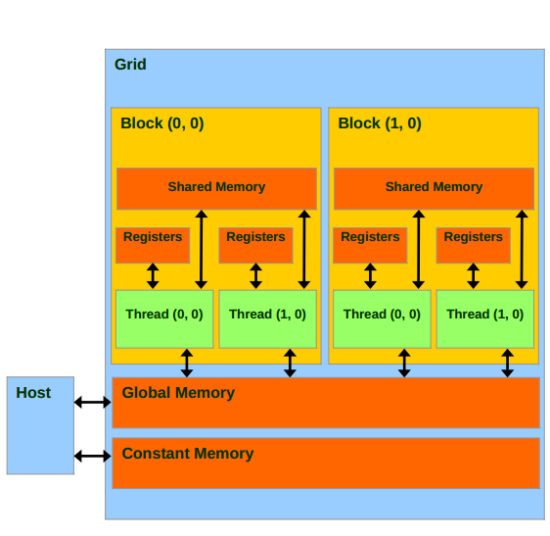
CUDA - Memory Model

Slide 4
CUDA - Memory Model (continue)
Each block contain following:
Set of local registers per thread.
Parallel data cache or shared memory that is shared by all the threads.
Read-only constant cache that is shared by all the threads and speeds up reads from constant memory space.
Read-only texture cache that is shared by all the processors and speeds up reads from the texture memory space.
Local memory is in scope of each thread. It is allocated by compiler from global memory but logically treated as independent unit.

Slide 5
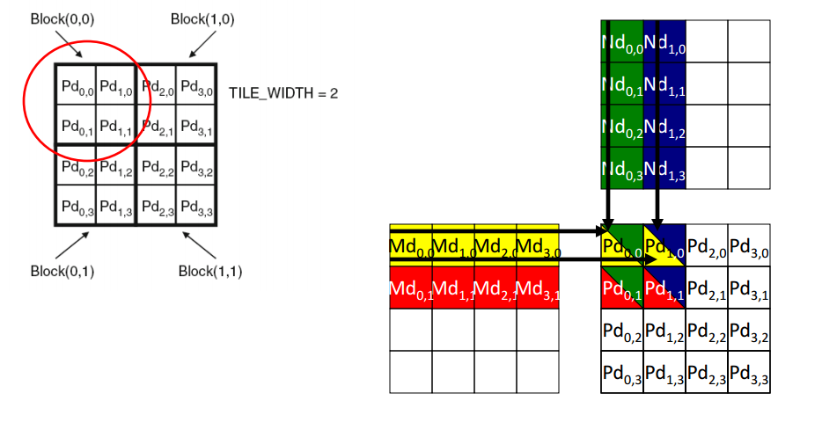
Matrix Multiplication

Slide 6
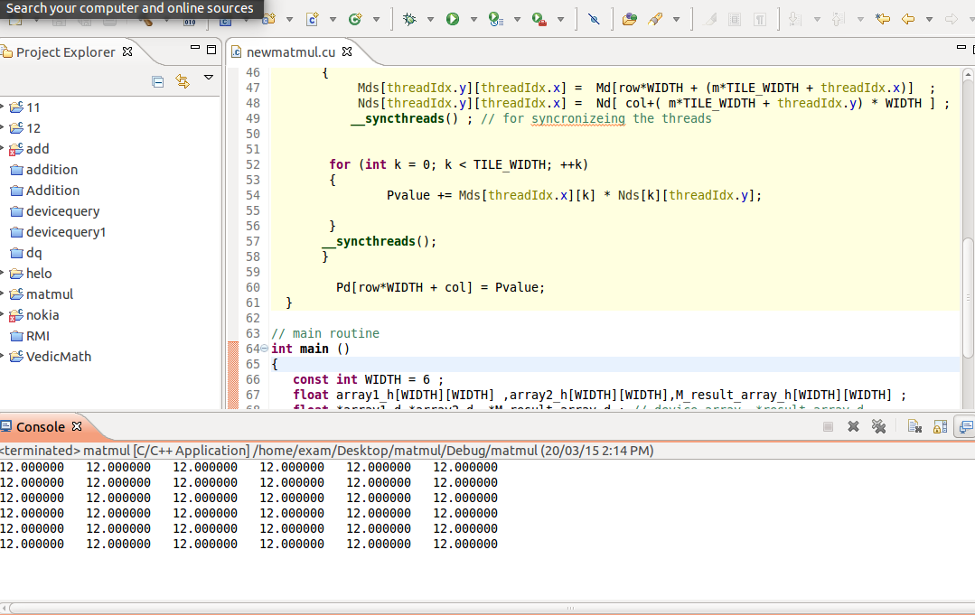

Slide 7
Thank You!

